Slide 1
Agricultural Policies in OECD Countries report 2006
Report describes short time changes and long term trends in OECD countries’ agricultural support.
Short term 05 v 04
Long Term 03-05 v 1986-1988
Changes over time in support to producers
Differences in support among countries
Composition of support

Slide 3
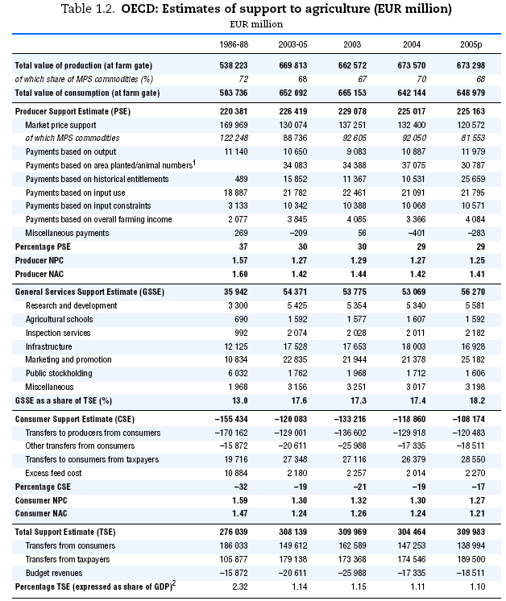

Slide 4
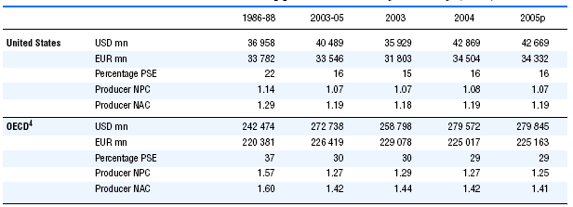

OECD producer support estimate by country

Slide 5
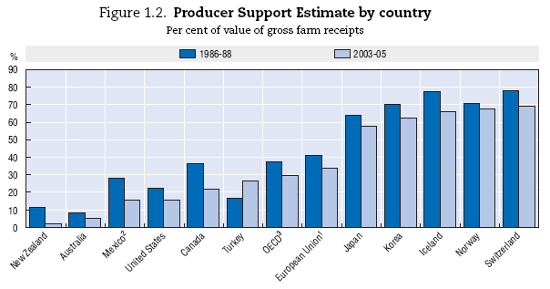

Slide 6
Differences in support among OECD countries
Why do these differences arise?
Variations in policy objectives
Different historical uses of policy instruments
Varying degree and pace of policy reform

Slide 8
Conclusion
Decrease in %PSE indicates improved market orientation.
In the long run all countries have reduced support (except Turkey)
MPS is falling which in turn is reducing the %CSE
Support to general services to agriculture is not uniform among OECD countries but ultimately improves long term productivity in the sector.

